Slide 1



QR YUMMY
(CS-691 Fall Team-3)
TEAMMATES:
Zubair Ahmed Baig Mogal
Gayathri Raj Patel
Soumyadip Chatterjee
Chitra Lekha Yatham
Robert Aliberti
Divyaa Mohankumar

Slide 2
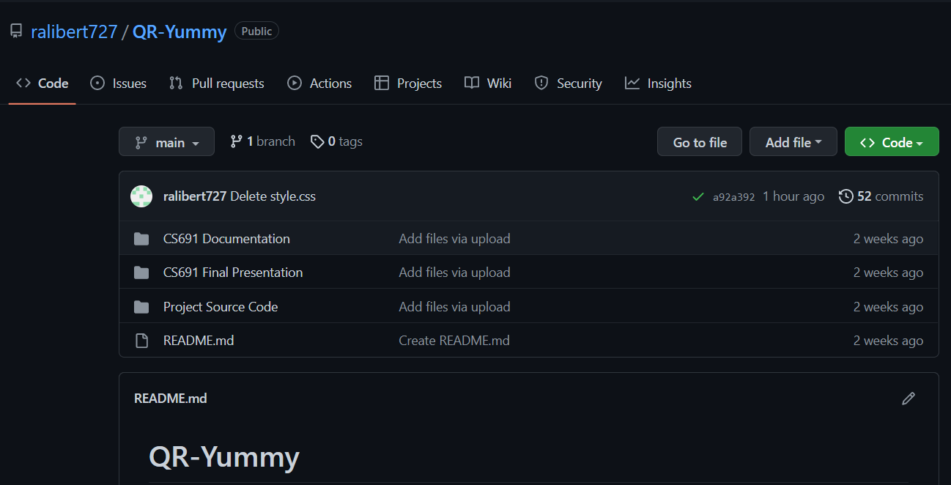
GITHUB REPOSITORY STRUCTURE
https://github.com/ralibert727/QR-Yummy

Slide 3
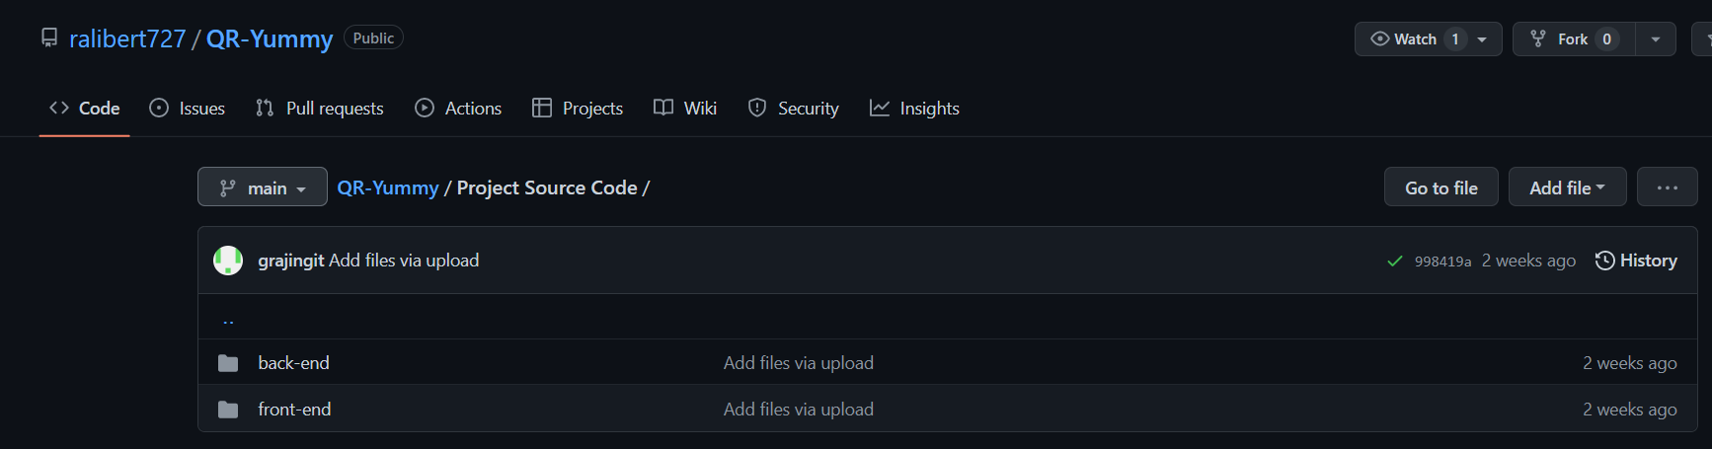
GITHUB REPOSITORY - Project Code
https://github.com/ralibert727/QR-Yummy/tree/main/Project%20Source%20Code

Slide 4
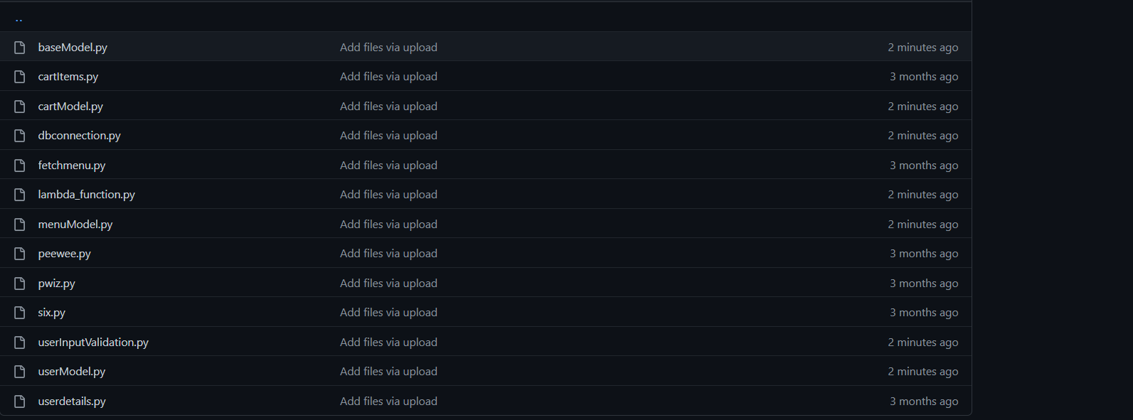
GITHUB REPOSITORY - Backend
https://github.com/ralibert727/QR-Yummy/tree/main/Project%20Source%20Code/back-end

Slide 5
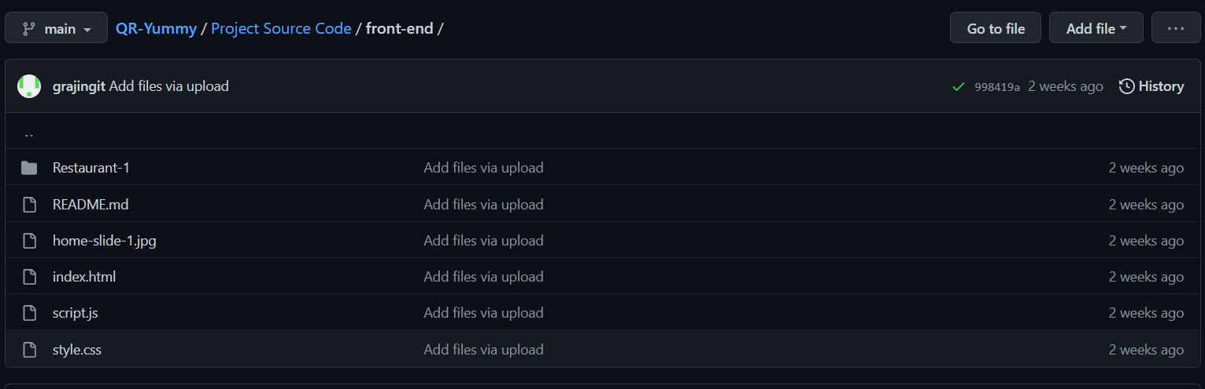
GITHUB REPOSITORY - Frontend
https://github.com/ralibert727/QR-Yummy/tree/main/Project%20Source%20Code/front-end

Slide 6
R1-I1

Slide 7
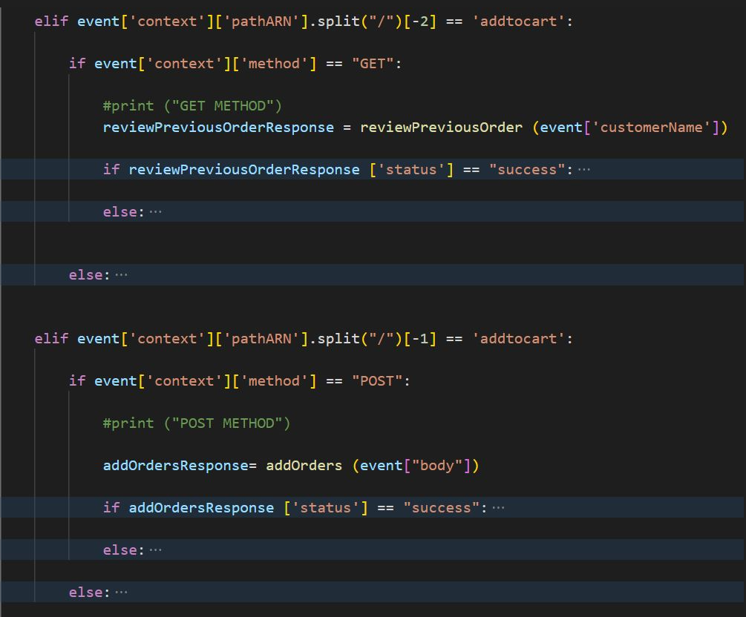
R1-I1 Source code samples
Feature 1: Add to cart(Module: 04.01)

Slide 8
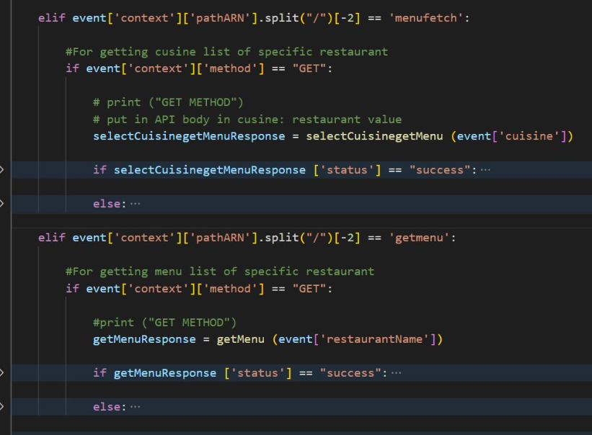
R1-I1 Source code samples
Feature 2: Select cuisine(Module: 03.01)

Slide 9
R1-I1 Source code samples
Feature 3: Select menu(Module: 03.02)

Slide 10
R1-I2

Slide 11
R1-I1 Source code samples
Feature 4: Review previous orders(Module: 02.04)

Slide 12
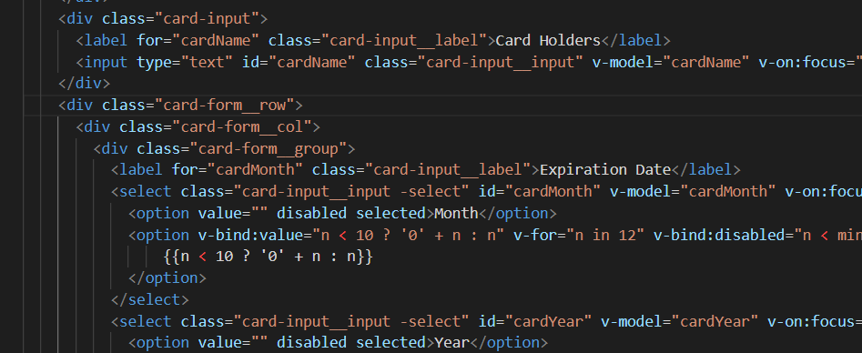
R1-I2 Source code samples
Feature 5: Add a payment method(Module: 02.06)

Slide 13
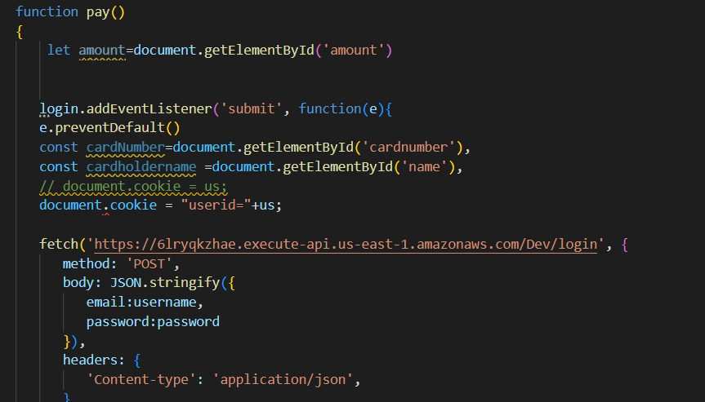
R1-I2 Source code samples
Feature 6: Make a payment(Module: 04.03)

Slide 14
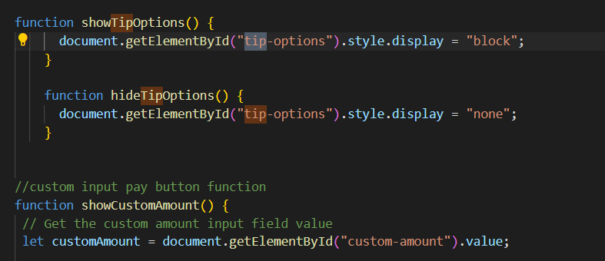
R1-I2 Source code samples
Feature 7: Tip the waiter(Module: 04.05)

Slide 15
Building & Deployment Procedure​
Prerequisites
An AWS account.
An AWS IAM User with programmatic key access and permissions to launch EC2 instances
Create a security group for your Amazon EC2 instance. If you already have one, you can skip to step 4.
Launch an Amazon EC2 instance.
Copy the public ipv4 address from EC2 address to webhook.
Install and configure Jenkins.
Create pipeline.
Run and make a build.
​

Slide 16
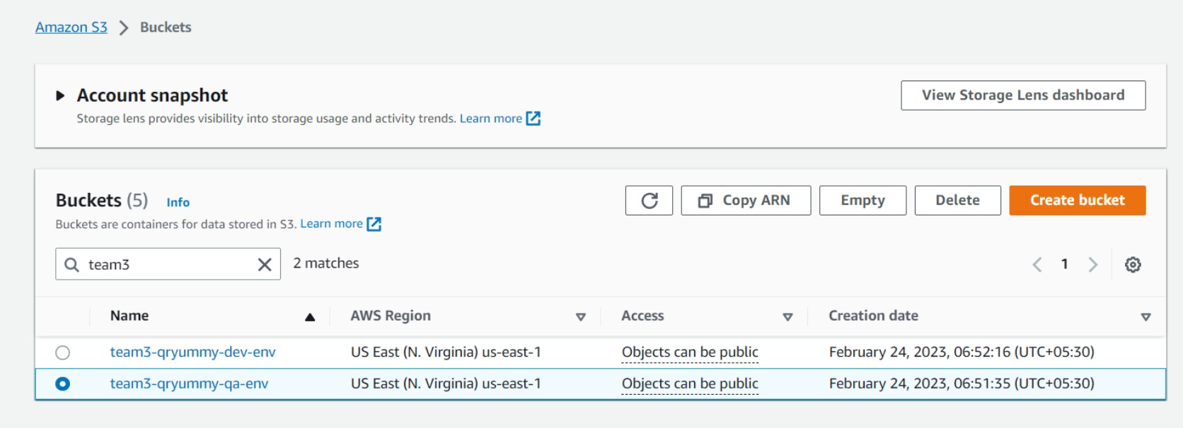
R1-I1 / R1-I2
DEV/QA ENV

Slide 17
Thank you.

